Slide 1
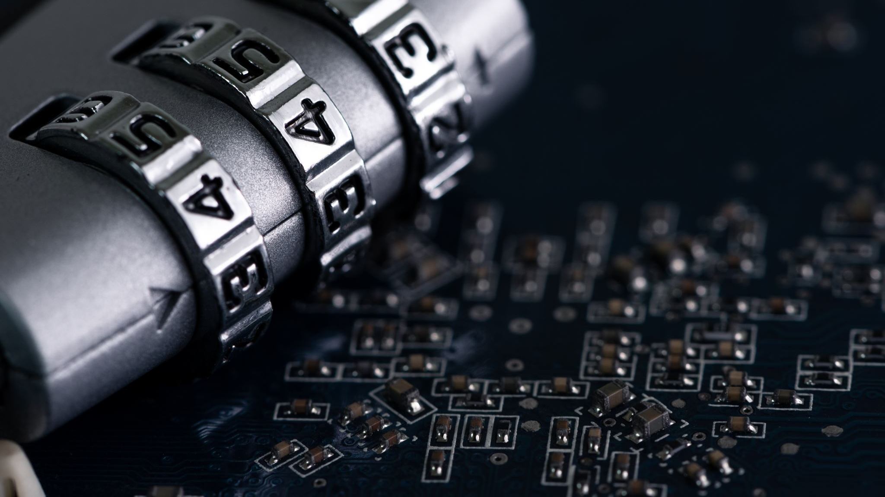
Evolution of Encryption: From DES to AES
Nithish Sunkara
Mallikarjun Reddy Theepireddy
Venakata Ganesh Upputuri
Indiana Institute of Technology
IS 5700 – Information Security & IT Governance
Changhao Chenli
April 28, 2025

Slide 2
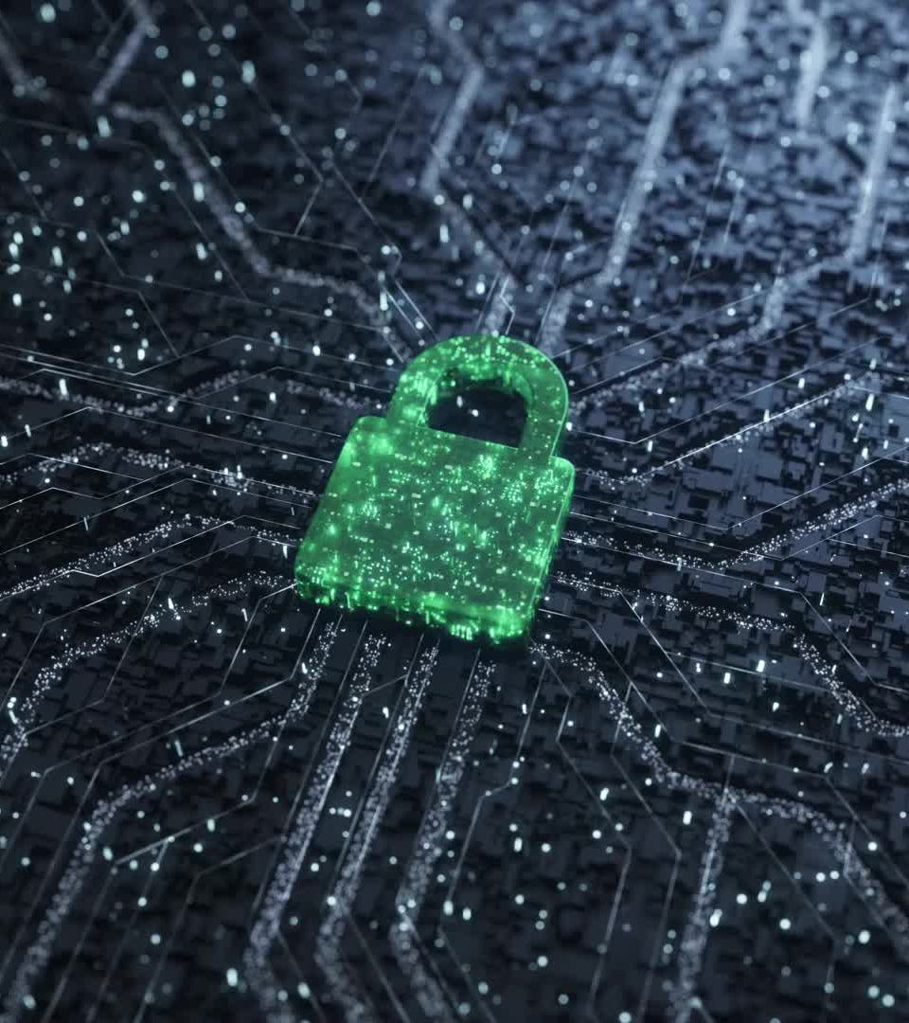
Introduction
Cryptography is the science of securing information.
Encryption protects data from unauthorized access.
Two major types: Symmetric (same key) and Asymmetric (public/private keys).
We'll focus on DES and AES – both are symmetric encryption algorithms

Slide 3
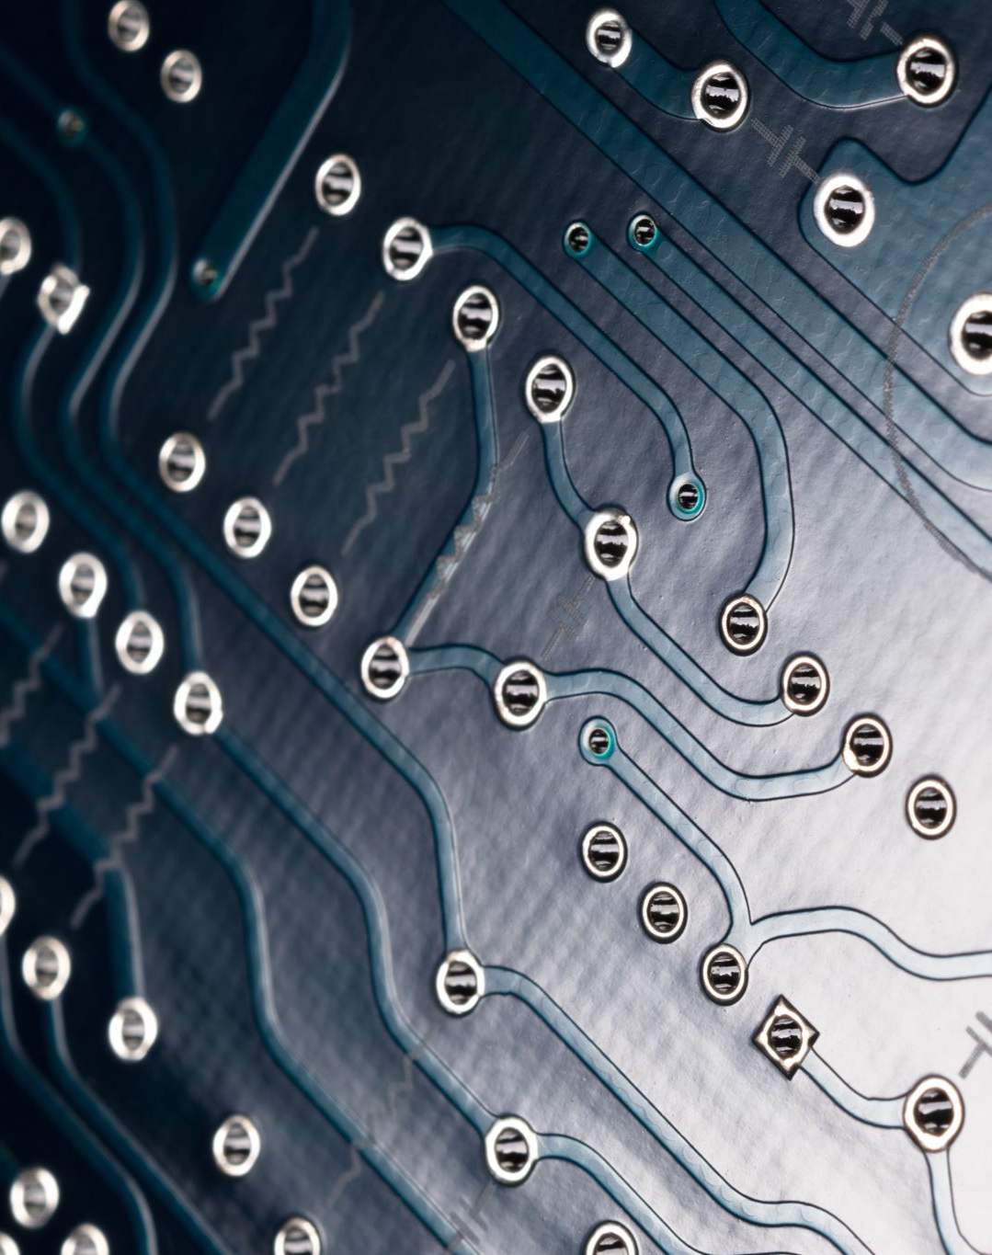
Symmetric Cryptography – Overview
Uses the same key for both encryption and decryption.
Faster and more efficient for large amounts of data.
Commonly used in:
File Encryption
Secure communications
Data at rest
Examples: DES, AES, Blowfish, RC4

Slide 4

What is DES?
Data Encryption Standard (DES) introduced by IBM in the 1970s.
Standardized by National Institute of Standards and Technology (NIST) in 1977.
Block cipher: encrypts data in 64-bit blocks.
Uses a 56-bit key.
Widely used in early internet and government systems.

Slide 5
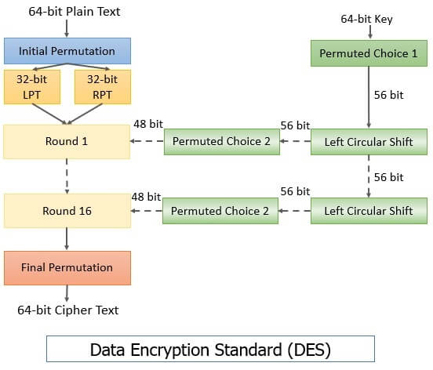
How DES Works
Initial Permutation (IP) of 64-bit plaintext.
16 rounds of Feistel operations:
Subkey generation
Expansion, substitution (S-boxes), permutation
Final Permutation (FP) gives 64-bit ciphertext.

Slide 6
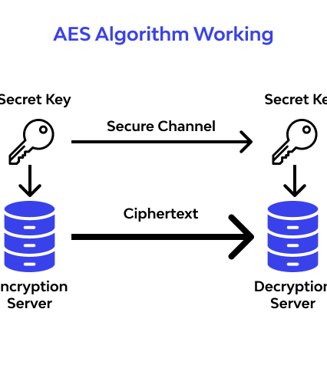
Limitations of DES
Key size too short: 56 bits → vulnerable to brute-force attacks.
Cracked by the EFF in 56 hours (1998) using dedicated hardware.
Cannot withstand modern computing power.
Insecure for use in most modern systems.

Slide 7

What is AES?
Advanced Encryption Standard (AES) selected by NIST in 2001.
Developed by Rijndael algorithm designers.
Block cipher with:
Block size: 128 bits
Key sizes: 128, 192, 256 bits
Still the global standard for secure encryption.

Slide 8

How AES Works
Operates on a 4x4 byte matrix (State matrix).
Steps:
SubBytes (S-box substitution)
ShiftRows
MixColumns
AddRoundKey
10, 12, or 14 rounds depending on key length.

Slide 9
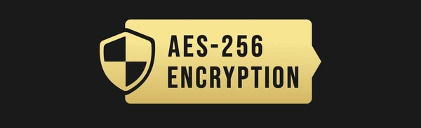
Why AES Replaced DES
Improved security:
Larger key sizes (128, 192, 256 bits)
Resistant to brute-force attacks
Better performance:
Faster in both hardware and software
Efficient design:
Simpler to implement securely
Global adoption:
Standard in SSL/TLS, WPA2, VPNs, etc.

Slide 10
Real-World Applications of AES
WiFi Security – WPA2/WPA3 Standards
Secure Messaging – Signal, Whatsapp use AES
Data Encryption – FileVault, BitLocker, VeraCrypt
Vitual Private Networks(VPNs) – AES -256 in Open VPN/IPSec

Slide 11

Security Challenges
AES is secure but:
Can be vulnerable to side-channel attacks (timing, power analysis)
Key management is critical
Secure implementation matters (avoid weak random numbers)

Slide 12

Future Outlook
AES remains the standard symmetric cipher.
Research into Post-Quantum Cryptography (PQC).
Hardware-based encryption and Zero Trust models gaining popularity.

Slide 13
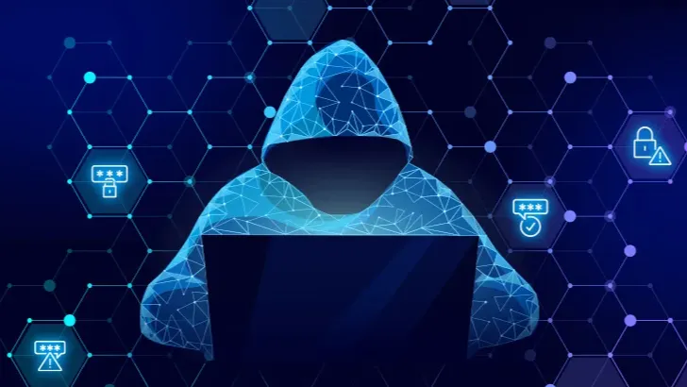
Conclusion
DES was revolutionary, but now outdated.
AES is faster, stronger, and scalable.
Understanding cryptographic evolution helps improve security standards.

Slide 14
References
Daemen, J., & Rijmen, V. (2002). The design of Rijndael: AES — the Advanced Encryption Standard. Springer-Verlag. https://doi.org/10.1007/978-3-662-04722-4
Menezes, A. J., van Oorschot, P. C., & Vanstone, S. A. (1996). Handbook of applied cryptography. CRC Press. https://doi.org/10.1201/9781439821916
Biham, E., & Shamir, A. (1991). Differential cryptanalysis of DES-like cryptosystems. Journal of Cryptology, 4(1), 3–72. https://doi.org/10.1007/BF00196725
Nechvatal, J., Barker, E., Bassham, L., Burr, W., Dworkin, M., Foti, J., & Roback, E. (2001). Report on the development of the Advanced Encryption Standard (AES). Journal of Research of the National Institute of Standards and Technology, 106(3), 511–577. https://doi.org/10.6028/jres.106.022
Vaudenay, S. (2001). Security flaws induced by CBC padding — Applications to SSL, IPSEC, WTLS.... Advances in Cryptology – EUROCRYPT 2002, Lecture Notes in Computer Science, 2332, 534–545. https://doi.org/10.1007/3-540-46035-7_35
Kelsey, J., Schneier, B., Wagner, D., & Hall, C. (1997). Side channel cryptanalysis of product ciphers. Journal of Computer Security, 5(1), 55–68. https://doi.org/10.3233/JCS-1997-5104

